Slide 1
Artificial Neural Network

Slide 2
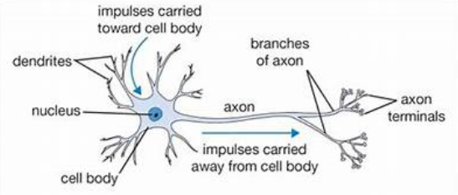
THE BRAIN AND THE NEURON
THE NEURON

Slide 3
Learning in animals
In animals, learning occurs within the brain. If we can understand how the brain works, then there might be things in there for us to copy and use for our machine learning systems.
The processing units of the brain are nerve cells called neurons. (more than 100 billion)
They come in lots of different types, depending upon their particular task.
Their general operation is similar in all cases: The chemicals within the fluid of the brain raise or lower the electrical potential inside the body of the neuron. If this membrane potential reaches some threshold, the neuron spikes or fires, and a pulse of fixed strength and duration is sent down the axon

Slide 4
Learning in animals
The axons divide into connections to many other neurons, connecting to each of these neurons in a synapse
After firing, the neuron must wait for some time to recover its energy (the refractory period) before it can fire again

Slide 5
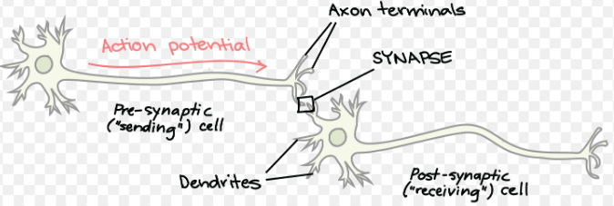
How neurons communicate with each other at synapses

Slide 6
Hebb’s Rule
Hebb’s rule says that the changes in the strength of synaptic connections are proportional to the correlation in the firing of the two connecting neurons.
So if two neurons consistently fire simultaneously, then any connection between them will change in strength, making it stronger.
However, if the two neurons never fire simultaneously, the connection between them will die away.
The idea is that if two neurons both respond to something, then they should be connected
Egs:

Slide 7
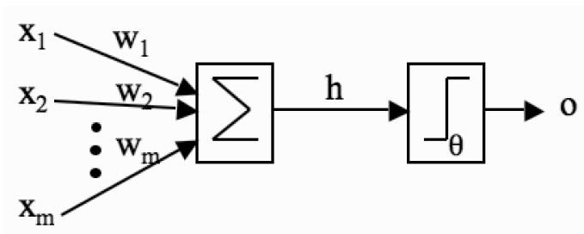
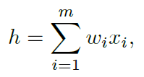
McCulloch and Pitts Neurons & Perceptron – Mathematical models
The inputs xi are multiplied by the weights wi, and the neurons sum their values. If this sum is greater than the threshold then the neuron fires; otherwise it does not.

Slide 8

Perceptron-Components
A set of weighted inputs wi that correspond to the synapses.
An adder that sums the input signals (equivalent to the membrane of the cell that collects electrical charge).
An activation function (a threshold function) that decides
whether the neuron fires (‘spikes’) for the current inputs
If synaptic weights are w1 = 1,w2 = −0.5,w3 = −1 and x1 = 1, x2 = 0, x3 = 0.5
h = 1 × 1 + 0 × −0.5 + 0.5 × −1 = 1 + 0 + −0.5 = 0.5
h = 0.5 in the example, and 0.5 > 0, so the neuron does fire,

Slide 9
Perceptron-Components
Real neurons are much more complicated
How should we change the weights and thresholds of the neurons so that the network gets the right answer more often?

Slide 10
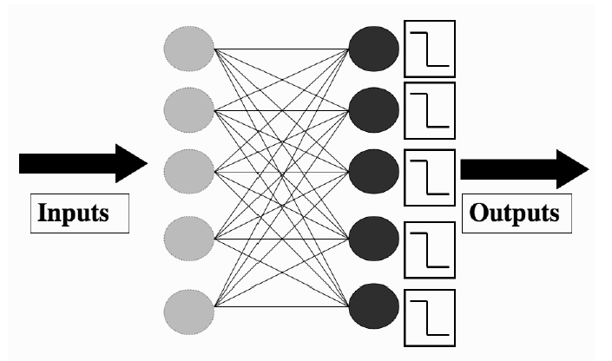
The Perceptron network
The Perceptron network, consisting of a set of input nodes (left) connected to McCulloch and Pitts neurons using weighted connections.

Slide 11
The Perceptron network
To work out whether or not a neuron should fire: we set the values of input nodes to match the elements of an input vector and then use below Equations for each neuron
and
For a neuron that is correct, we are happy, but any neuron that fired when it shouldn’t have done, or failed to fire when it should, needs to have its weights changed

Slide 12


The Perceptron network
If the neurons gets the wrong answer for an input vector,(its output does not match the target)
There are m weights that are connected to that neuron, one for each of the input nodes.
If we label the neuron that is wrong as k, then the weights that we are interested in are wik, where i runs from 1 to m.
Change the values of these weights by
Apply a learning rate also, usually labelled as

Slide 13
The Bias Input
When all the inputs are zero, irrespective of the the weights , the result will be zero (since zero times anything equals zero). The only way that we can control whether the neuron fires or not is through the threshold.
If it wasn’t adjustable and we wanted one neuron to fire when all the inputs to the network were zero, and another not to fire, then we would have a problem.
Now, we add an extra input weight to the neuron, with the value of the input to that weight always being fixed

Slide 14
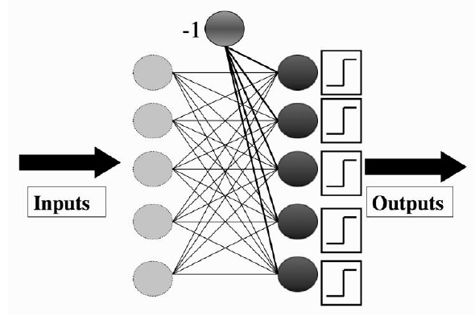
Bias input

Slide 15
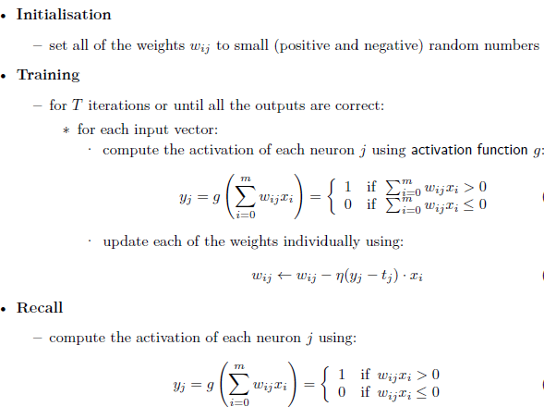
The Perceptron Learning Algorithm

Slide 16
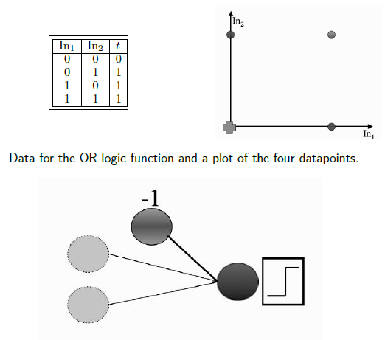
The Perceptron network for OR logic function

Slide 17
Perceptron Network Example
The algorithm tells us to initialize the weights to small random numbers, so we’ll pick w0 = −0.05,w1 = −0.02,w2 = 0.02.
Now we feed in the first input, where both inputs are 0: (0, 0). Remember that the input to the bias weight is always −1, so the value that reaches the neuron is −0.05 × −1 +−0.02 × 0 + 0.02 × 0 = 0.05.
This value is above 0, so the neuron fires and the output is 1,which is incorrect according to the target
The update rule tells us that we need to apply
to each of the weights separately (we’ll pick a value of = 0.25 for the
example):

Slide 18


Perceptron Network Example
Now we feed in the next input (0, 1) and compute the output
0.2*-1+-0.02*0+0.02*1=-.2+0.02=-0.1.8 < 0 which will not fire and it is wrong. So update the weights
For the (1, 0) input
-0.05*-1+-0.02*1+0.27*0= 0.05+-0.02=0.03, which will fire, the answer is correct.

Slide 19
Perceptron Network Example (cntd.)
For the (1, 1) input the answer is already correct
-0.05*-1+-0.02*1+0.27*1= 0.05+-0.02 +.27=.30, which will fire.
For the (0, 0) input
-0.05*-1+-0.02*0+0.27*0= 0.05, which will fire.
the answer is incorrect.
Update the weights and continue the steps

Slide 20
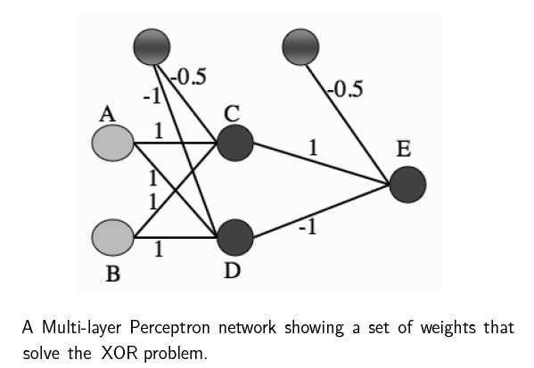
Multi Layer Perceptron
Just as it did for the Perceptron, training the MLP consists of two parts:
-working out what the outputs are for the given inputs and the current weights
-updating the weights according to the error, which is a function of the difference between the outputs and the targets

Slide 21
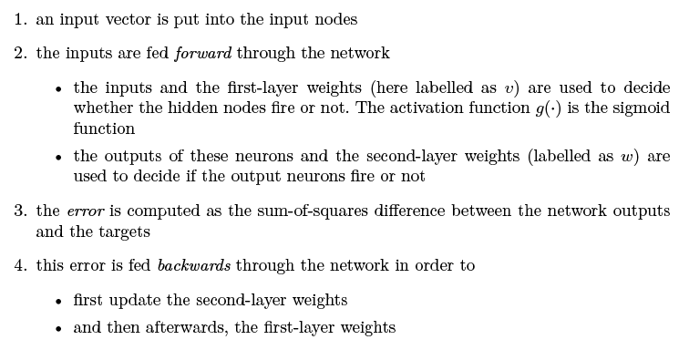
The Multi-layer Perceptron Algorithm

Slide 22
